Slide 1
reactathon
Notes:
Topics Covered:
ECMAScript 6
React Basics
Redux
React Router

Slide 2

ES6
Notes:
We aren’t going to cover all of ES6 features in great detail but you will see many of them used in the code base and React examples so it’s a good idea to have a foundation of some of the key features introduced in ECMA Script 6

Slide 3
ES6 (ECMAScript 2015)
6th edition to the ECMAScript standard released in 2015
First update since ES5 released in 2009
Introduced some major syntax and features such as classes, modules, arrow functions, promises…
ES7 — Finalized in 2016 (Array.prototype.includes(), ** exponent operator)
ES8 — Finalized June 2017 (async/await)
ES.Next
Notes:
ECMA International Organization
Each browser’s JavaScript engine is responsible for deciding how JavaScript will behave but they all need to adhere to the ECMAScript standard.
The first standard was created in December 1995 and prior to ES6 had 5 major releases.
The last large update and most commonly used version of JavaScript is known as ES5 and was released in 2009.
ES6 or ECMAScript 2015 contained a large number of new features. In order to avoid large releases like this there are plans to now release a new version each year and having the standard named after the year.

Slide 4

Const / let / var
var — function scoped variable that can be reassigned (pre ES6)
let — like var but block scoped (scoped to the nearest {}) rather than function scoped
for(var i = 0; i<10; i++) {
console.log(i)
}
console.log(i)
for(let i = 0; i<10; i++) {
console.log(i)
}
console.log(i)
10
I is not defined!
Notes:
One of the first big changes was the introduction of new variable types let and const.
Prior to them there was only var which was a function scoped variable — being function scoped has let to some odd behaviour of variables in JavaScript (like the example below) so it should be abandoned in favour of let or const.
Let is similar to var but is block scoped instead — so if you review the example below the i in the for loop is not the same as in the console.log.

Slide 5
Const / let / var
const — blocked scoped (like let) variable that cannot be reassigned
However you can reassign properties
// Foo cannot be reassigned
const foo = 213
const bar = {
name: 'Bar',
color: 'Green'
}
// Bar.name can be reassigned
bar.name = 'Blue'
Use const when you can, but if you must reassign use let
Notes:
Const is function scoped, like var, but cannot be reassigned (you will get an error).
However you can still reassign properties of objects or elements of an array.
In general use const if you can but if you need to reassign use let (do not use var).

Slide 6
Deconstruction
Unpack values from arrays or properties from objects into variables
Object Deconstruction
Array Deconstruction
const person = {
name: 'Bob',
age: 32,
occupation: 'Dancer'
}
const {name, age, occupation} = person
const person = {
name: 'Bob',
age: 32,
occupation: 'Dancer'
}
const {name: firstName, age, occupation: jobTitle} = person
Renaming the deconstructed args
const iterable = ['a', 'b'];
const [x, y] = iterable;
x = ‘a’ and y = ‘b’
Notes:
A handy syntax introduced is deconstruction — which allows you to break apart of JavaScript object or an array into variables in a single line, rather than needing to assign them one by one.
Example the person object is broken down into it’s properties name, age, and occupation.
You can even rename the deconstructed args in the syntax.

Slide 7
Arrow functions
Less verbose syntax for function definitions
const multiply = function (x,y)
{
return x * y
}
As Arrow Function
const multiply = (x, y) => { return x * y }
Parameter Syntax
Body Syntax
() => { /*...*/ } // no parameter
x => { /*...*/ } // one parameter, an identifier
(x, y) => { /*...*/ } // several parameters
x => { return x * x } // block
x => x * x // expression
No brackets will return result automatically
No rebinding of this to reduce usage of bind
Notes:
One of the more anticipated features is arrow functions — these are just a more compact and less verbose version function definition.
As you can see comparing the tradition function definition you can now have the arguments followed by the arrow syntax into the function body.
There are a few variations of the syntax depending on the function
If you have only a single argument you can omit the brackets
If you function is a single line that returns the results you can omit the curly braces and return statement
Another key features of arrow functions is the do not rebind and have their own version of this this (if you don’t know what this is don’t worry too much).
In traditional functions if you referenced this in a function you would get the function unless you explicitly rebound it to something. With arrow functions this is just the this of the defining code.

Slide 8
Classes
More syntactic sugar over Prototypical Inheritance
Allows inheritance with the extends keyword
Some Features:
Class Methods
Static Methods
Constructor
Gettings/Setters
class Rectangle {
constructor(height, width) {
this.height = height;
this.width = width;
}
// Method
calcArea() {
return this.height * this.width;
}
}
const square = new Rectangle(10, 10);
console.log(square.calcArea()) // 100
Notes:
Not going into all the details of classes but it is important to know they exist in ES6 as they are used in React’s Class Components as we will see a little later.
They have many of the same properties of classes in Object Orientated languages such as class methods, constructors, inheritance.
At the end of the day they are still static sugar over JavaScript’s Prototypical Inheritance.
There is some debate over the inclusion of classes in ECMA script so I wouldn’t encourage over using them but it’s important to know they exist.

Slide 9
Promises
A Promise is an object representing the eventual completion or failure of an asynchronous operation
Promise Construction — constructor takes 2 call backs
resolve — get called upon successful execution completion
reject — gets called upon error during execution
function asyncFunc() {
return new Promise(
function (resolve, reject) {
try {
const result = logicToGetResult()
resolve(result);
} catch (error) {
reject(error);
}
});
}
resolve called with result on success
reject called on error
Notes:
Promises are nothing new to the JavaScript world — they have existed in many for such as PolyFills or as parts of popular libraries such as JQuery/Angular. But now they are officially part of the standard.
A promise is just a delayed execution of code — this helps deal with asynchronous code that previously would lead to call back hell.
You don’t often construct a promise but if you needed to it takes 2 call backs as parameters:
The resolve gets executed when the code successfully completes passing in any values to be returned
The reject gets executed if there is an issue with the execution passing back an error

Slide 10
Promises
Using Promise
then — get executed if the Promises invoked the resolve callback with any returned value
catch — gets executed if the Promises invoked the reject
then called with result on success
asyncFunc()
.then(result => {
console.log(result)
})
.catch(error => {
// Handle errors
});
catch called on error
Notes:
Promises make much more sense when you look how they are used.
When you make an asynchronous promise you can chain 2 calls off of it:
then will be executed when the promise completes successfully taking in the results as an argument — this would be is the resolve call back was executed.
catch is executed when if the error reject was invoked with the error.

Slide 11
Promises
Chaining Multiple Promises:
asyncFunctionOne(a, b)
.then(result1 => {
console.log(result1);
return asyncFunctionTwo(result1);
})
.then(result2 => {
console.log(result2);
}).catch(error => {
// Handle errors of asyncFuncOne() and asyncFuncTwo()
})
Second .then called when asyncFunctionTwo resolves
Catches errors from either first or second promise
Notes:
Promises are also powerful in that they can be chained together with the results of the first promises being passed to the next .then method.
A single catch statement can catch any errors in any of the promises.
In the above a second promises is invoked within the then of the first promise.

Slide 12
Promises - Async/await
Build upon Promises to help further synchronize asynchronous code.
Promise
Async/Await
await must be within an async function
const makeRequest = () =>
getJSON()
.then(data => {
console.log(data)
return "done"
})
const makeRequest = async () => {
console.log(await getJSON())
return "done"
}
With async/await
await pauses function until promise is resolved
async functions actually return another promise
Notes:
A powerful features introduced in ES6 is async/await which works with promises but cleans up the asynchronous code making it feel and look more synchronous.
The function needs to be declared a async function, what this means is the function will actually return a promise it’s self.
Within the async function you can add await before any promise and the code will automatically stop until the promise is completed.
So both examples a request for JSON is made and once the request completed the data is printed to the console and “done” is returned.

Slide 13
Promises - Async/await
Promises
Async/Await
const makeRequestComplex = () => {
return getJSON()
.then(data => {
if (data.needsAnotherRequest) {
return makeAnotherRequest(data)
.then(moreData => {
console.log(moreData)
return moreData
})
} else {
console.log(data)
return data
}
})
}
const makeRequestComplex = async () => {
const data = await getJSON()
if (data.needsAnotherRequest) {
const moreData = await makeAnotherRequest(data);
console.log(moreData)
return moreData
} else {
console.log(data)
return data
}
}
Notes:
For small examples this may not seem that useful but it’s much more powerful as you started getting chained promises with lots of conditional logic.
In the above both examples do the same thing but the flow in much easier to follow in the async/await where there is no more nested .then calls.

Slide 14
Modules
Separating code into their own files (known as modules) which do not expose their variables and functions outside the file unless explicitly exported
CommonJS — Standard that inspired Node exports
Server Side Focus, Compact Syntax, Synchronous Loading
AMD (Asynchronous Module Definition) - Require.js
Browser Focus, Asynchronous Loading, More Complex Syntax
ES6 Modules
Tries to be best of both: Compact Syntax with Asynchronous Loading
Notes:
Modules give the ability to split up code into their own files. Importantly this means their variables and functions are not globally exposed unless they are explicitly exported.
Like many other ES6 features they are nothing new to JavaScript, prior to ES6 there were two very well known module loaders, CommonJS — inspiration for NodeJS and AMD — used by Require.js.
They both solved the same problem but one had the clients interest in mind while the other was developer for more sever side solutions so they each came with their own appropriate trade off.s
CommonJS was similar but didn’t allow for asynchronous loading while AMD had more complex but did.
ES6 module loading was designed to be the best of both with compact syntax and asynchronous
Loading.

Slide 15
Modules
Named Export
Modules can have as many named exports as you want
Can export functions, classes, objects…..
export const square = x => x*x
export const squareRoot = x => Math.sqrt(x)
export function diag(x, y) {
return sqrt(square(x) + square(y));
}
Import uses a relative path
import {square, squareRoot, diag} from './module_one'
Named imports go in curly braces{}
Notes:
A JavaScript module is just a file, but the important part of it is the exports — as this is the part that other files can access.
Almost anything can be exported, functions, classes, objects variables…
There are two types of exports the first being the named export.
Modules can have as many named exports as they want and can export any type.
When importing then you just need to include the import name in the curly braces. You will notice that one file imports another module using it’s relative path.

Slide 16
Modules
Default Export
Modules can only have ONE default export
export default function(){}
Import of default export can be renamed ANYTHING
import foo from './module_one'
import foo, {square, squareRoot, diag} from './module_one'
Mixed import of default and named exports
Node Modules
Node modules are referenced by the module name (like ‘react’)
import React, { Component } from ‘react’
import {connect} from 'redux'
import axios from 'axios'
Notes:
The second type of export is the Default exports — unlike the Named export there can only be one of the per class.
They are imported without being in the curly braces and they can also be named anything you want in the import.
Finally if you are imported installed node modules then you refer them by their module name like in the example.

Slide 17
Babel
JavaScript Compiler — Use next generation JavaScript, today
Allows you transpile different source codes into JavaScript
ES6/ES.Next —> ES5
JSX —> ES5
Flow —> ES5
https://babeljs.io/repl/
Notes:
So ES6 support isn’t university across all browsers and may not even ever be supported by older browsers so why are we even talking about them?
The answer is transpires — like babel!
Transpilers are responsible for converted one source code to another, in Babel’s case it converts something into JavaScript.
Like converting ES6 source code to ES5 compatible source code.
In React apps since you already need a compiler for JSX, which we will cover more later, you can very easily add one for ES6 and beyond.

Slide 18
NPM/Yarn
JavaScript Package Managers — register of node_modules
NPM (Node Package Manager)
Yarn — build by Facebook, Google, etc… to solve commonly faced problem with NPM
Introduced the ‘lock’ file
Same packages as NPM
package.json — contains all of a project dependencies
Notes:
Another important tool you will see today is package manager such as NPM or Yarn.
Both serve the same function, yarn came about to solve the issues companies like Facebook and Google had with NPM.
But both these use a package.json file to install and manage different library dependencies.

Slide 19
Package.json
{
"name": "react-example",
"version": "1.0.0",
"description": "Simple React example app",
"main": "index.js",
"scripts": {
"dev": "webpack-dev-server --inline --content-base ./ --env.dev",
"build": "webpack --env.prod",
"lint": "eslint app test",
"test": "cross-env NODE_ENV=test nyc mocha",
"watch:test": "mocha --watch --compilers js:babel-register",
"start": "http-server",
"setup": "npm install && npm run validate",
"validate": "npm-run-all lint test build"
},
"repository": {
"type": "git",
"url": "https://github.com/mzabriskie/react-example"
},
"author": "Matt Zabriskie",
"license": "MIT",
"bugs": {
"url": "https://github.com/mzabriskie/react-example/issues"
},
"homepage": "https://github.com/mzabriskie/react-example",
"dependencies": {
"axios": "0.13.1",
"bootstrap": "^3.3.5",
"history": "^3.0.0",
"moment": "^2.10.6",
"react": "15.3.0",
"react-dom": "15.3.0",
"react-router": "2.6.1",
},
"devDependencies": {
"babel-core": "6.13.2",
"babel-loader": "6.2.4",
"babel-plugin-istanbul": "1.0.3",
"babel-preset-es2015": "6.13.2",
"babel-preset-react": "6.11.1",
"babel-preset-stage-2": "6.13.0",
"babel-register": "6.11.6",
"chai": "3.5.0",
"chai-enzyme": "0.5.0",
"css-loader": "0.23.1",
"enzyme": "2.4.1",
"eslint": "3.2.2",
"eslint-config-kentcdodds": "^9.0.2",
"file-loader": "0.9.0",
"http-server": "0.9.0",
"jsdom": "9.4.1",
"lodash": "4.14.2",
"mocha": "3.0.2",
"moxios": "0.3.0",
"npm-run-all": "2.3.0",
"nyc": "7.1.0",
"react-addons-test-utils": "15.3.0",
"sinon": "1.17.5",
"webpack": "2.1.0-beta.20",
"webpack-config-utils": "2.0.0",
"webpack-dev-server": "2.1.0-beta.0",
"webpack-validator": "2.2.7"
}
}
Build/Test/Run/Lint Scripts
Project metadata
Production Dependencies
Development Dependencies
(testing and building)
Notes:
A typical package.json file.
In addition to the project’s meta data there are three main sections
Scripts
Production Dependencies — libraries that should go in the final production build
Development — libraries that should are used for things like building and testing that do not get used in the production build

Slide 20
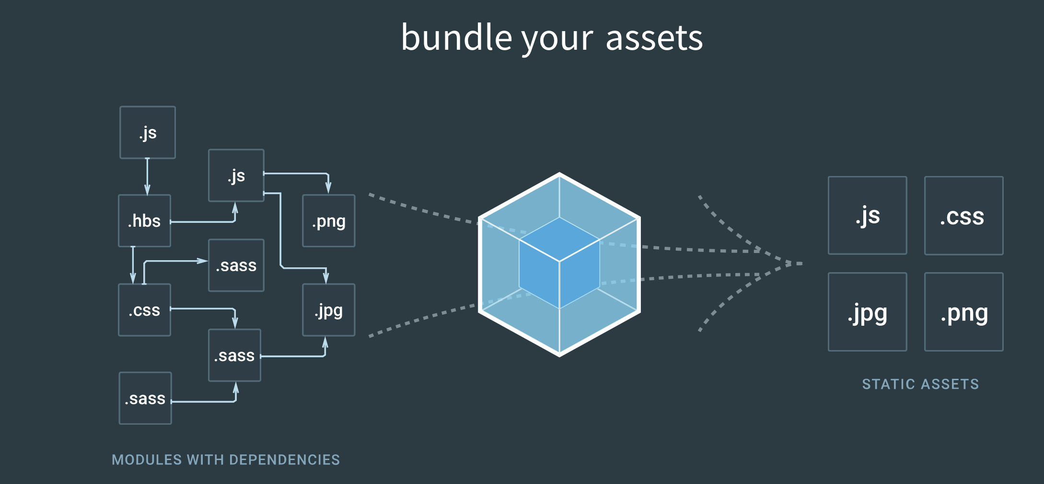
Webpack
Modular Bundler for JavaScript
Bundles all your files (javascript, images, styles, …) and their dependencies into a few static files using a series of Plugins and Loaders
Loaders: Preprocess files before bundling (example babel-loader for JavaScript transpiling, SASS/Less loader for CSS compiling,
Optimizations:
Minimize/Uglify
Tree Shaking (dead-code elimination)
Code Splitting
Notes:
The last important tool we will look at is Webpack — a modular bundler for JavaScript.
Webpack is capable of taking all of your JavaScript source code, images, css and combining them all into very few static files.
It also has configurable optimizations such as minimization, tree shaking, and code splitting.
For the code today we are using create-react-app which hides away web pack so you don’t need to know much about it to learn React.

Slide 21










Webpack config
import path from 'path';
import HtmlWebpackPlugin from 'html-webpack-plugin';
export default () => ({
entry: [
path.join(__dirname, 'src/index.js'),
],
output: {
path: path.join(__dirname, 'dist'),
filename: 'bundle.js',
},
plugins: [
new HtmlWebpackPlugin({
filename: 'index.html',
template: './src/index.html'
}),
]
module: {
rules: [
{
test: /.js?$/,
exclude: /node_modules/,
include: path.join(__dirname, 'src'),
use: [
{
loader: 'babel',
options: {
babelrc: false,
presets: [
['es2015', {modules: false}],
'react',
],
}
}
]
},
{
test: /\.(css|scss|sass)$/,
loader: 'style!css!sass',
},
]
},
});
Starting Entry Point
Final output directory and filename
Plugins
babel loader on js files
Loaders
style/sass loaders
Notes:
Sample web pack configuration

Slide 22

React

Slide 23
React
Declarative component based UI library developed by Facebook
Been developed at Facebook since ~2011 and was open sourced in 2013
Latest stable release React 16 (code name React Fiber) was released in September 2017 and included a new reimplementation of React’s core algorithm (without changing any of the API)
Notes:
For the main topic of this training is React.
In short React is a declarative component based UI library developed and open sourced by Facebook.
Unlike many of the current frameworks like Angular, Meteor, Ember React only focuses on the UI part of the front end — leave the rest of the application to you.
The latest very anticipated release of React, React 16 (code name fiber) just came out in September and was a complete rewrite of the reconciliation algorithm.

Slide 24
Virtual DOM
Notes:
The main advantage of React is it’s usage of the virtual dom — React builds up it’s own internal virtual DOM of what the real DOM should look like. Whenever this virtual dom is changed React’s reconciliation algorithm compares the ‘current DOM’ with the ‘expected DOM’ and only changes the parts of the real DOM it needs to.
DOM manipulation is SLOW so by reducing it as much as possible you are able to build very high performance applications.

Slide 25
Introduction
Two main modules React and React-DOM
React DOM is responsible for DOM interactions - most importantly rendering the initial React application in the DOM:
import ReactDOM from 'react-dom';
ReactDOM.render(
<h1>Hello, world!</h1>,
document.getElementById('root')
)
Inserting an <h1> element into element with id root
import ReactDOM from 'react-dom';
ReactDOM.render(<App />, document.getElementById('root'));
Insert the <App> component
Notes:
When you first install React in your project you will notice there are 2 modules you need — React and React-DOM.
React contains the majority of the core logic and is also shared by React Native (React’s Multiplatform mobile framework).
React-DOM’s main, and likely only, job is to hook up your react application with the DOM.
In your html page served to the client you need to have a single element that React needs to hook into — the hook is done by ReactDOMs render method. This takes the Component or Element to render and the Dom node to render in
In the top example ReactDOM will render the H1 tag in the element with id root.
In the second example ReactDOM would render the <App/> component into the same node.

Slide 26
Jsx
JavaScript XML — syntactic extension of JavaScript that allows you describe what your UI should look like
Syntax may look like HTML or a templating language but it is fully functional JavaScript
<h1>
{2+2}
</h1>
Expressions can be evaluated within curly brackets ({})
const element = <h1>Hello, world!</h1>
style takes an object
const MyComponent = <span>Hello world</span>
const element = <div tabIndex=0 style={{color: 'green', background:'blue'}} className="my-class">< MyComponent/></div>
DOM Attributes become camel case
class —> className because class is a keyword
Notes:
One of the first things you will see in React apps is JSX — JSX looks very close to HTML or a templating library but it is infact “JavaScript” so you can write pure JavaScript code within JSX and it will execute properly — instead of needing handlers or helpers like in a templating language.
Behind the scenes a transpires like Babel will convert JSX into actual JavaScript in the final JavaScript bundle sent to the client but writing JSX in the source code is much easier than writing the transpired version.
JSX is meant to describe what your UI should look like.
So in the above example you can see some simple examples like a h1 tag or a span and you can also see actual executed of pure JavaScript code — this just needs to be in a set of curly brackets.
There are some gotcha when using html attributes and keywords:
Html DOM attributes need to be converted to camel case
Styles take a JavaScript object instead of styles
Class needs to be converted to className
https://babeljs.io/repl/

Slide 27
Components
Class Component
Class that extends React.Component
import React, {Component} from 'react'
class Welcome extends Component {
render() {
return <div>Welcome!</div>
}
}
export default Welcome
Component State
Component Lifecycle methods
More verbose
Render method returns JSX
Functional Component
import React from 'react'
const Welcome = () => {
return <div>Welcome!</div>
}
export default Welcome
No State or Lifecycle methods
More concise
Returns JSX to be rendered
import Welcome from './Welcome'
const App = () => {
return <div><Welcome/></div>
}
<Welcome> can be imported and used in another component’s JSX
Notes:
Now that we know about JSX we can start learning about the most important piece of React — Components.
A component should represent a view in your application — and it can be and should be a very small view, a React application is made up of many many nested smaller components.
The main goal of the component is to return some JSX that React can use to build up the virtual DOM.
When we talk about Component’s there are two main types which some subtle differences:
Class Components are the more complex components — they are a ES6 class that extends either React’s Component or React’s Pure Component.
They are more verbose but they can with added benefit of they are use React’s lifecycle method and can have internal state.
The only required part of class component is the render method that returns the JSX for the component.
Functional Components are much more light weight than class components and are simply a function that returns the JSX.
They should be used if your component does not have complex logic but they do not have access to state or lifecycle methods.
Each component is typically contained init’s own module and exported as the default export

Slide 28
Props
Props — a means of passing information from a parent Component to a child component
Read Only within a component
props passed to children as tag attributes
<App>
<Welcome firstName='Jane' lastName='Smith'/>
</App>
Class Component
props accessed via this.props
class Welcome extends Component {
render() {
return <div>Welcome {this.props.firstName} {this.props.lastName}!</div>
}
}
Functional Component
props passed as the parameter to the function
const Welcome = (props) => {
return <div>Welcome {props.firstName} {props.lastName}!</div>
}
Notes:
The next thing about Component’s to talk about is Props — these are a means of passing information down the component hierarchy from a parent to a child.
A parent can pass a child component properties as attributes on the tag in the JSX.
In the above example the <Welcome> component is being passed the firstName and lastName props that it can use to render.
The props can be access in each type of component slightly differently.
In Class components they are accessed via this.propName, since class components are classes after all.
In Functional components the props are actually passed in as an argument to the function.
Within a child component the props are immutable and cannot be changed — they can only be changed by the parent component.

Slide 29
STATE
While props are a way to pass data from parent to child State is a components internal data store
Class component only
Plain JavaScript Object
Accessed with with this.state
Manipulated this.setState
Isolated to the component — cannot be accessed by component’s children or parents
Notes:
While props are ways of passing information from a parent to a child state is a way to store information within a component.
Unlike props, state is only available within class components not functional components.
It can be set and manipulated within each component but is not accessible outside of the component from the parent or any children components.
State is just a plain JavaScript Object.

Slide 30
STATE
Initialized in the component’s constructor
Access with this.state
class Counter extends Component {
constructor(props) {
super(props)
this.state = {
count: props.initialCount
}
}
render() {
return <div>Count: {this.state.count}</div>
}
}
constructor initialization
Accessing state via this.state
Notes:
State is access with this.state.property
It can be initialized in the constructor but if it doesn’t need props to be initialized it can also be initialized as a static

Slide 31
STATE
Setting state with this.setState:
this.setState({count: 2})
Merges new count will all other state properties
Object.assign(
previousState,
{count: state.count + 1},
{count: state.count + 1},
...
)
this.setState is asynchronous
this.setState ((prevState, props) => {
return {count: prevState.count + 1}
})
Instead of an object pass an updater function
Notes:
State is mutated using this.setState padding in a JavaScriptObject —> the properties passed into setState are merged with the existing properties on the state object.
WARNING: setState is asynchronous — meaning if there are multiple independent calls to it they can be grouped together so if you rely on previous state in the update you may get some un-expected results.
The work around for this is to use the updater function version of setState that takes in the previous state and props and updates the state.
Finally because setState is asynchronous if you have code that relies on the state being updated successfully you need to utilize the optional callback function.

Slide 32
Life cycle methods
Class components have hooks into several of React’s Lifecycle methods
4 Categories:
Mounting
Updating
Unmounting
Error Handling (new to React 16)
Notes:
Another features of Class components are Life Cycle methods.
These are methods that allow you component to hook into some of React’s internal stages.
Mounting — is when the component is added to the DOM
Updating — is when the component receives new props or has their state updated
Unmounting — is when the component is being removed from the DOM
Error Handling — is a special case introduced in React 16

Slide 33
Life cycle methods
Mounting — Called once when the component is first being inserted into the DOM:
constructor(props) {
super(props)
this.state = {
count: props.initialCount
}
}
constructor(props)
componentWillMount(props)
Avoid componentWillMount
render()
componentDidMount(props)
componetDidMount() {
fetch('https://gitconnected.com')
.then((res) => {
this.setState({
user: res.user
});
});
}
Dom manipulation and data loading in componentDidMount
Notes:
The Mounting phase — when the component is inserted into the DOM, has 3 main phases
Constructor — a component is created but not yet in the DOM — this is the place to set up initial state off the props
render — Returns the JSX that represents the components view
componentDidMount — once the component is in the DOM, here you should do any changes that require DOM manipulation or data loading
While componentWillMount still exists it should not be used, instead the constructor and componentDidMount should contain your logic.

Slide 34
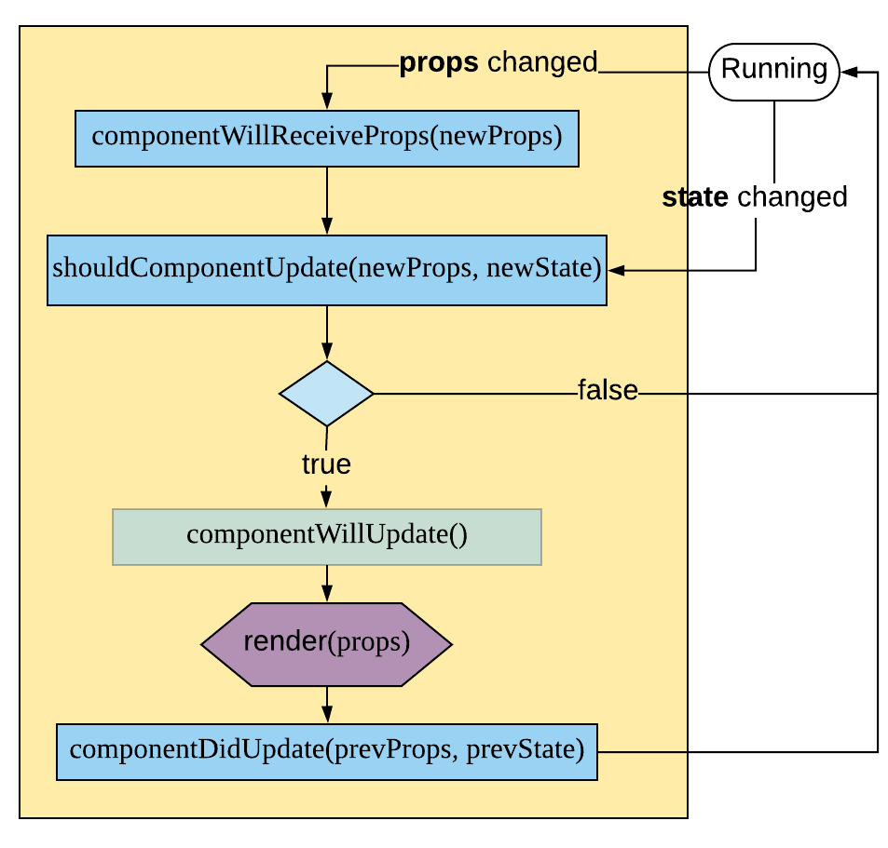
Life cycle methods
Updating — Called many times in a component’s life cycle in response to changes in this.props or this.state
Props changed
componentWillReceiveProps(newProps)
shouldComponentUpdate(newProps, newState)
componentWillUpdate()
State changed
Avoid componentWillUpdate
render()
componentDidUpdate(prevProps, prevState)
Notes:
The updating phase happens when the component either receives new props from the parent or has updated it’s internal state.
componentWillReceiveProps — is only called when the component actually receives new props
shouldComponentUpdate — called when either new props are received or the internal state is updated
render — same render as in the mounting
componentDidUpdate — is called once the DOM changes have been completed
Similar to componentWillMount, componentWillUpdate should not be used as the other lifecycle methods should be sufficient.

Slide 35
Life cycle methods
componentWillReceiveProps(newProps)
Called when new props are passed in from the parent
componentWillReceiveProps(nextProps) {
if (this.props.id !== nextProps.id) {
this.setState({
feedContent: []
});
}
}
shouldComponentUpdate(newProps, newState)
Determines if a component should should re-render based on the new props and state
shouldComponentUpdate(nextProps, nextState) {
return this.props.color !== nextProps.color
}
Override for required optimizations only
Notes:
componentWillReceiveProps — is a great place to update your state based on the props if anything needs to be synced between the child and the parent
shouldComponentUpdate — is a pure optimization that lets you check if your props or state has changed and only render if they have. By default this function returns true but in general it’s not normally needed as it’s normally faster to just like the rerender than to do this check.
You can also extend PureComponent which will shallow compare the state and props within shouldComponentUpdate.

Slide 36
Life cycle methods
componentDidUpdate(prevProps, prevState)
Called after a component has re-rendered after a change
componentDidUpdate(prevProps, prevState) {
// only update chart if the data has changed
if (prevProps.data !== this.props.data) {
this.chart = c3.load({
data: this.props.data
});
}
}
Place for code requiring DOM interactions
Notes:
componentDidUpdate is like componentWillMount in that it’s the best place to put any code that requires DOM interactions after reloading.
In the above example if the underlying data changed we need to have c3 charting library update with it.

Slide 37
Life cycle methods
Unmounting — begins just before a component is about to be removed from the DOM (unmounted)
Simple lifecycle method componentWillUnmount
Place for any clean up like removing event listeners or timers
componentWillUnmount() {
window.removeEventListener('resize', this.resizeEventHandler);
}
Error Handling
Introduced in React 16 - componentDidCatch allows you to create Error Boundaries
class ErrorBoundary extends React.Component {
constructor(props) {
super(props);
this.state = { hasError: false };
}
componentDidCatch(error, info) {
// Display fallback UI
this.setState({ hasError: true });
logErrorToMyService(error, info);
}
render() {
if (this.state.hasError) {
// You can render any custom fallback UI
return <h1>Something went wrong.</h1>;
}
return this.props.children;
}
}
Notes:
Unmounting occurs when the component is about to me removed from the DOM and only contains a single method componentWillUnmount which is the best place to clean up anything like listeners or timers.
Newly introduced in React 16 is an error handling method componentDidCatch will be be run if the any of the children components encounter a run time error and gives you an opportunity to render a nicer error message.
Prior to this if there was a run time javascript error React would often be left in a inconsistent often unrecoverable state.

Slide 38
Higher Order components
Pattern developed to facilitate avoiding code duplication and replace depreciated mixins
Function that takes in a component to be wrapped and returns a new component with additional functionality
function logProps(WrappedComponent) {
return class extends Component {
componentWillReceiveProps(nextProps) {
console.log('Current props: ', this.props);
console.log('Next props: ', nextProps);
}
render() {
return <WrappedComponent {...this.props} />
}
}
}
Creates a new component with a custom componentWillReceiveProps
Returns the original component passing in all the props with the spread operator
const MyComponent extends Component {
render() {
return <div>Component to be Wrapped</div>
}
}
export default logProps(MyComponent)
Notes:
While technically not part of core React High Order Components are a very common pattern that is used to avoid code duplication and replace the depreciated mixins.
Seeing as React components are classes it may be tempting to just extend different components from another but this ends up being a fairly large anti-pattern and should be avoided.
Instead HOC are a function that passes in the component to be ‘enhanced’ — it then creates a new component will any new functionality and returns the original component in the render method making sure to pass all props spread in.
In the above example the HOC adds a lifecycle method to log all changes to the component.
We will see a good example of HOC in redux.

Slide 39

Redux

Slide 40
Redux
Redux is library build to simplify and centralize application state which predicable changes.
Enforces unidirectional data flow based on Flux Architecture
3 Core Concepts
Single Source of Truth
Store is Read Only
Changes are made with Pure Functions
Notes:
Not office part of React, Redux is used by many react application to manage global state and interactions between components.
It follow the architecture pattern of Flux which dictates all data flow should be unidirectional
The main concepts are there is a single of truth, the read only store and changes to the store are made through Pure functions — that is functions without side effects that do not modify the original state.
The basic flow of a redux application is a view will have an event triggered, example button press timer event… that will dispatch an action.
This action will go through a reducer that will take the action and the current state and return a new state based on the change dictated in the actions.
This new state get published to all the component’s listening who will then rendering accordingly.

Slide 41
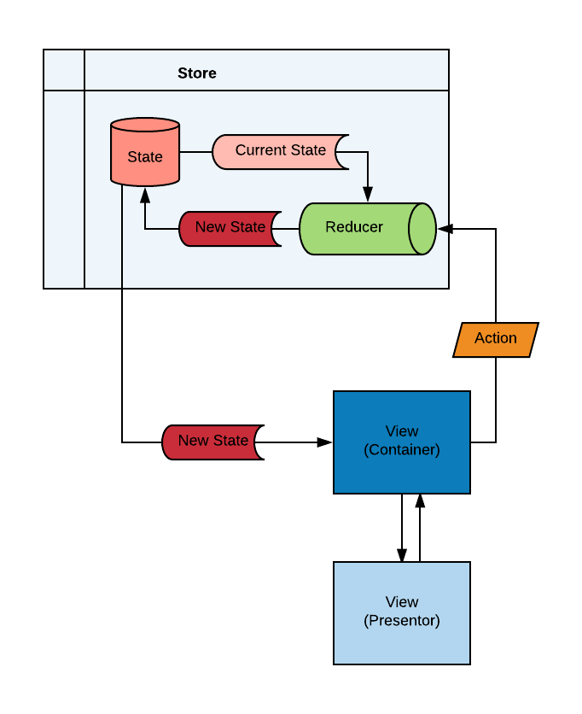
Redux
Store State Updated
Action Dispatched
New State Published
Event Triggered
Notes:
Not office part of React, Redux is used by many react application to manage global state and interactions between components.
It follow the architecture pattern of Flux which dictates all data flow should be unidirectional
The main concepts are there is a single of truth, the read only store and changes to the store are made through Pure functions — that is functions without side effects that do not modify the original state.
The basic flow of a redux application is a view will have an event triggered, example button press timer event… that will dispatch an action.
This action will go through a reducer that will take the action and the current state and return a new state based on the change dictated in the actions.
This new state get published to all the component’s listening who will then rendering accordingly.

Slide 42
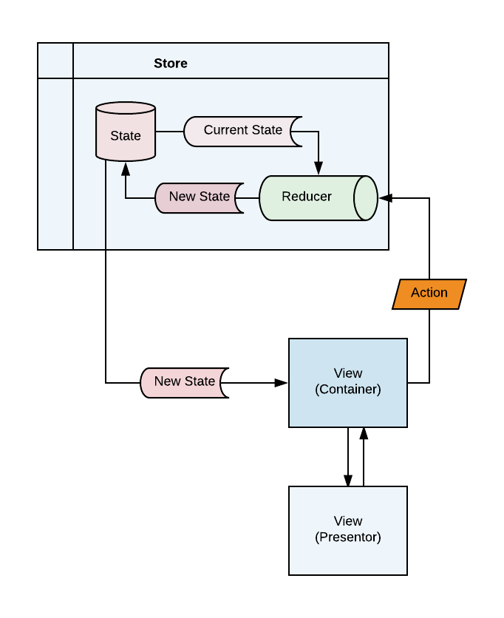
Redux - Actions
Actions
Plain JavaScript Object that describes a change potential changes to the store
Must contain a type
const ADD_TODO = 'ADD_TODO'
const addAction = {
type: ADD_TODO,
text: 'Buy milk from the store'
}
Action Creators
Common pattern — functions that are responsible for creating actions
const addTodo = text =>{
return {
type: ADD_TODO,
text: 'Buy milk from the store'
}
}
Notes:
So actions are just plain JavaScript objects that contains a type and may contain some type of payload. In the explain the type is to add a TODO to list and the payload is the text to add.
A common pattern is to create action creators that will take in the payload and create the appropriate action — this was the action creators can be used by different views throughout the application.

Slide 43
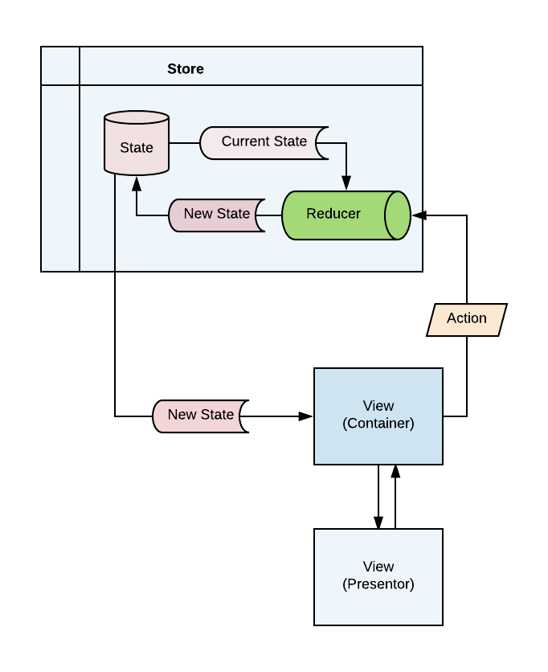
Redux - Reducers
Functions responsible for generating new state based on the Action and Previous State
(previousState, action) => newState
Must be PURE — cannot mutate the previous state
{
type: SET_COLOR,
color: ‘green'
}
Assigns default initial state
const reduce = (state = {}, action) => {
switch (action.type) {
case SET_COLOR:
return Object.assign({}, state, {color: action.color})
case SET_QUANTITY:
return Object.assign({}, state, {quantity: action.quanity})
default:
return state
}
Returns previousState if no changes performed
Notes:
Next up is the reducers that operate on these actions.
They are just a pure function that takes in the current state and the actions and returns a new state depending on the action.
In the above example the reducer is creating a new object and assigning it an updated property depending on the actions.
The reducer always needs to return something even if it can’t handle the particular action — in which case it should return the current state.
It also needs to handle the initial state — an easy way to do this is with ES6 default property.
While is may get annoying it is very important that you do not just mutate the old state — reduce will compare the new and the old state to know when to publish changes and if you just mutate the original state your changes may not get picked up properly.

Slide 44
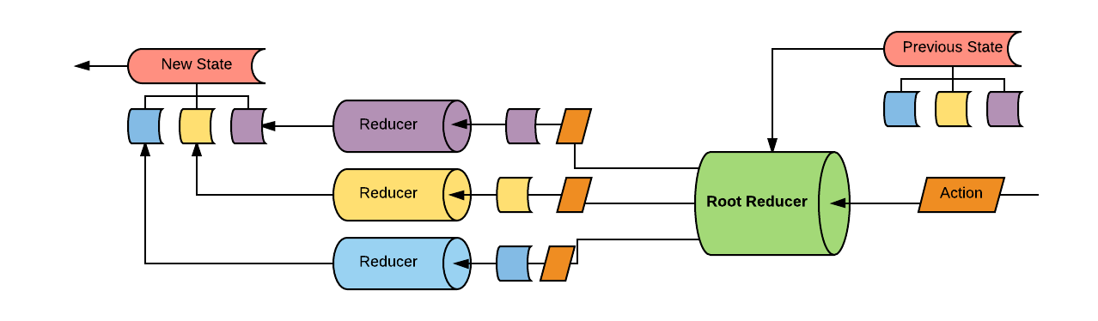
Redux - Reducers
Multiple reducers can be combined to form a tree of reducers — the top level state will also be
import combineReducers from 'redux'
import potatoReducer from './potato'
import tomatoReducer from './tomato'
rootReducer = combineReducers({
potato: potatoReducer,
tomato: tomatoReducer
})
Resulting nested state
{
potato: {
// ... potatoes, and other state managed by the potatoReducer
}
tomato: {
// ... tomatoes, and other state managed by the tomatoReducer
}
}
Notes:
Your application will likely grow to a point you don’t want a single reducer to handle all of the logic, fortunately redux lets you merge multiple reducers together and it passes all the combined reducers every actions.
An important thing is how this changes the shape of the state.
The top level state is now broker down into a nested state with each reducer being part of the state tree. When invoked this reducer only get’s the part of the state is is responsible for.
So if an actions is invoked both the potato and tomato reducers will receive it but tomato reducer only receives the tomato part of the state.

Slide 45
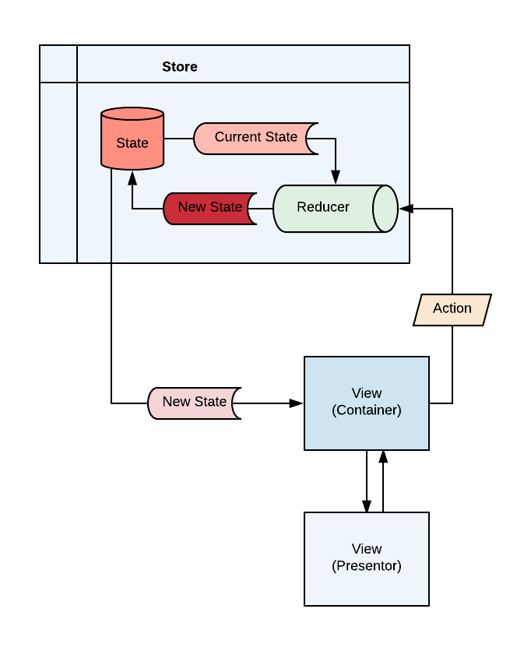
Redux - State/Store
State
Single plain JavaScript object containing nested structure for the entire application
Lives within the Store
Store
Holds the state
Allows actions to be dispatched to update state
Notifies subscribed listeners on state changes
import { createStore } from 'redux'
import app from './reducers'
const store = createStore(app)
Initialized with root reducer
Notes:
As mentioned before state is just a Plain JavaScript object and it lives within the Store.
The Store in addition to holding state is also responsible for receiving actions and passing to the reducer as well as notifying view when something changes in the state.
When a store is created you need to pass it a reducer or the root reducer created by merging all the reducers.

Slide 46
React redux bindings
Library that contains a series of bindings that greatly help integrate Redux into a react app
Provider wraps entire app
import {Provider} from `react-redux`
ReactDOM.render(
<Provider store={store}>
<MyRootComponent />
</Provider>,
rootEl
)
Provider takes in the created store as a prop
Provider gives all of the children component’s access to the store via the second binding connect
Notes:
Passing the store around between all the component would get quite cumbersome so fortunately the author of Redux also wrote a mobile of react-redux bindings that make the interacting between your React Component’s and the Redux store more seamless.
The first part you from the redux binding is a Provider which will be passed your newly created redux store.
This provider will allow any child component to access the store being using the second binding connect.

Slide 47
React redux bindings
Connect is a Higher Order component that takes 2 main functions as parameters:
mapStateToProps(state, [ownProps]): stateProps
mapDispatchToProps(dispatch, [ownProps]): dispatchProps
const mapStateToProps = state => {
return {
todos: state.todos
}
}
Extract redux state and injects them into the component as props
const mapDispatchToProps = dispatch => {
return {
onTodoClick: id => {
dispatch(toggleTodo(id))
}
}
}
Create functions that allow the component to dispatch actions to the redux store and injects them as props
Notes:
Connect is a HOC that ‘connects’ the component to the store as long as the component is a child of a Provider, it does so using two methods that correspond to the two jobs of the store:
Accepting dispatches actions
Notifying subscribers on state changes.
The first method mapStateToProps receives the entire state from the store and returns a new object that will end up as the components prop. This lets you map what each component needs from the store and just pass that to the component.
The second method mapDispatchToProps receives a dispatch method and allows you to return another object that contains methods used to dispatches changes to the store.
These methods normally make usage of the action creators discussed.

Slide 48
React redux bindings
import React, { Component } from 'react'
import { connect } from 'react-redux'
import UserProfile from './UserProfile'
import { updateProfile } from './profileActions'
class Profile extends Component {
render() {
const { profile, updateProfile } = this.props
return <UserProfile firstName={profile.firstName} lastName={profile.lastName} email={profile.email}
updateProfile={updateProfile}/>
}
}
const mapStateToProps = state => {
return {
profile: state.profile
}
}
const mapDispatchToProps = dispatch => {
return {
updateProfile: (profile) => dispatch(updateProfile(profile))
}
}
export default connect(mapStateToProps, mapDispatchToProps)(Profile)
Notes:
In this example we have a Profile component that we are connecting the redux via the connect method.
The mapStateToProps extracts the current profile from the store and adding it to the Profile component will it can user to render the users profile.
The mapDispatchToProps returns a single method that can be called when the profile is updated to dispatch the method to the store.

Slide 49
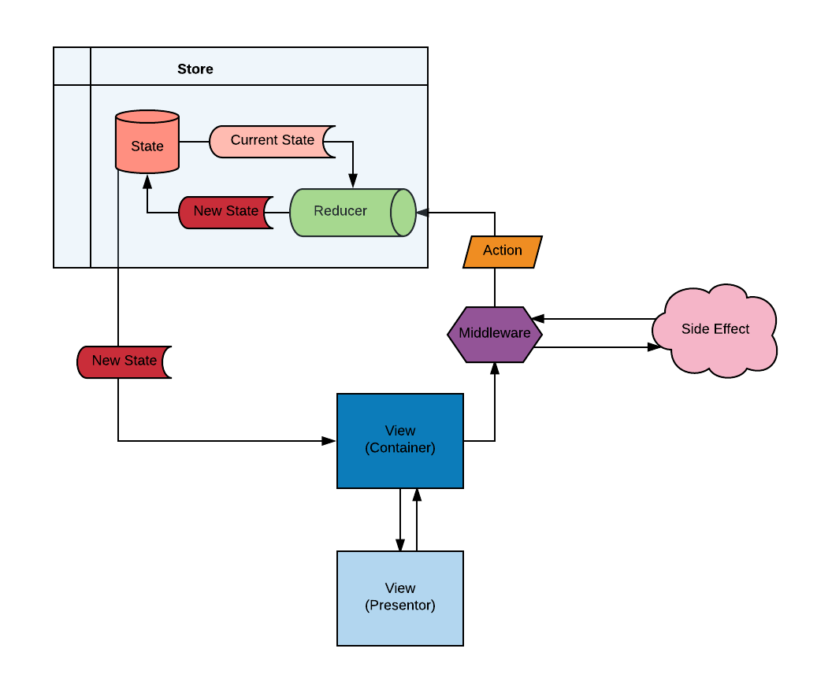
React side effects - Middleware
Redux Middleware — Provides 3rd party extension points between dispatching an action and it reaching the reducer.
Api Calls, Logging, etc…
Many middleware for asynchronous logic:
Redux-Thunks
Redux-Saga
Redux-Promise
Notes:
One of the largest issues people run into run into when building a React/Redux application is where to put side effects like loading data or saving data to the server?
Redux has a concept of middleware which is extension points between an action being dispatched and it reaching the reducers.
There are a few different middleware that help with asynchronous logic like making an Ajax call to a server like Redux-Thunks, Redux-Saga or Redux Promise but in the training we will use Redux Thunks for it’s simplicity and powerfulness.

Slide 50
React side effects - thunks
Thunks allow you to dispatch a function to your store instead of just an action object
This function allows the delay of dispatching the action until after the asynchronous call has completed
function setCats(cats) {
return {
type: 'SET_CATS',
cats
}
function loadCats(catType) {
return async function (dispatch) {
const cats = await loadCatsofType(type)
return dispatch(setCats(cats))
}
}
Thunk returns a function with dispatch as it’s parameter
store.dispatch(loadCats('Siamese'))
Notes:
In essence thunks let you dispatches functions to your stores instead of just plain javascript objects — these funtions allow for the delay of the dispatching the final actions to the store.
They are passed the dispatch action so when the complete their asynchronous code execution they can then dispatch the appropriate action with the final payload.
In the above example the loadCats actions create takes in a catType and returns a function that takes in the dispatch as an argument.
It makes an asynchronous call to load the cats here we are using async/await to simplify the promised and when the promise completes it dispatches a the final setCats action to update the store with the loaded cats.

Slide 51
React router
Notes:
The final topic we will cover very briefly is React Router.
Like redux this is not official part of React but is the most commonly used Routing library in for React application and it will be used during the training.

Slide 52
React router
The most populate routing library for React apps
The entire app should be wrapped in a <Router> components
Individual <Route> components map urls to specific components
<Link> components allow for navigation within the application
import {BrowserRouter as Router} from 'react-router-dom'
<Router>
<div>
<ul>
<li><Link to="/">Home</Link></li>
<li><Link to="/about">About</Link></li>
<li><Link to=“/topics”>Topics</Link></li>
<li><Link to=“/profiles/123”>Profile</Link></li>
</ul>
<hr/>
<Route exact path="/" component={Home}/>
<Route path="/about" component={About}/>
<Route path="/topics/" component={Topics}/>
<Route path=“/profiles/:id” component={Profile}/>
</div>
</Router>
<Link> provide navigation links
<Routes> map urls to components
Notes:
To use React Router you need to wrap your entire application within a Router component.
Within the Router you define <Route> components that have a defined path, if that path matches the current url that component defined on the Route will be rendered in where the <Route> is.
Inside that Router you can also use <Link> components to redirect the user to different routes.

Slide 53
React router
Component’s passed to Router get passed 3 props from the Router:
match — information about the matched url to extract params
location — information where the app is and query params
history — allows for programatic navigation
const Child = ({ match, location, history }) => (
<div>
<h3>ID: {match.params.id}</h3>
</div>
)
Notes:
Finally within a component defined on the Route there are special props automatically passed in:
Contains information about the matched url such as path parameters
Location contains information like the query parameters
History allow for programmatic navigation without using the <Link> component

